Slide 1
Editorial Cartoons
Techniques cartoonists use and how to analyze them

Slide 2
What is an editorial cartoon?
An illustration containing commentary about current events and personalities.
Cartoonists want to project an opinion or get viewers to look at the subject in a certain way. Thus, they contain opinion and are persuasive in nature.

Slide 3
Analyzing a cartoon: Step 1
Look at the cartoon and identify what the cartoon is about.
This is surface-level analysis. Don’t worry about the deeper meaning of the cartoon just yet.

Slide 4
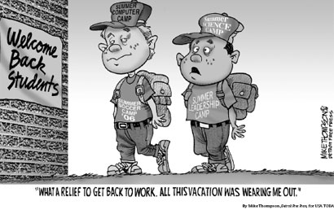

Slide 5
Example
This cartoon is about two boys who were active in summer camps returning to school.

Slide 6
Analyzing a cartoon: Step 2
Look for the deeper meaning.
What is the artist really trying to say?
What is the artist’s opinion on this matter?

Slide 8
Example
The artist is trying to say that school is too easy for students and that students often work harder in the summer.
I know this because the students are saying, “what a relief to get back to work. All this vacation was wearing me out” and they are wearing their summer camp shirts.

Slide 9
Analyzing a cartoon: Step 3
Identify what techniques the cartoonist used to get his/her point across.
Most cartoons use one of the following techniques:
Analogy
Irony
Labeling
Symbolism
Exaggeration

Slide 10
Techniques cartoonists use to persuade
Analogy: comparing two things based on some resemblance or commonality (even though they aren’t very alike in reality)
Irony: occurs when there is a difference between what happens and what we expect to happen
Labeling: used in cartoons to mark or identify a person, place, or thing.
Symbolism: when something is used to represent something else.
Exaggeration: when something is dramatically over-emphasized

Slide 12
Example
Labeling is used on the sign “Welcome Back Students” and on the hats and t-shirts of the students “Summer Computer Camp,” “Summer Science Camp,” “Summer Soccer Camp,” and “Summer Leadership Camp.”
Irony is used. We don’t expect students to find summer more difficult than school. This is shown when the students say, “What a relief to get back to work. All this vacation was wearing me out.”

