Slide 1
AN INTRODUCTION TO JOURNALISM
Mrs. Macomber

Slide 2
WHAT IS JOURNALISM?
“an academic study concerned with the collection and editing of news or the management of a news medium” -Merriam-Webster Online Dictionary
“the profession of writing or communicating … for the benefit of a particular community of people”
-Wikipedia.org

Slide 3
TYPES OF JOURNALISM
Print: newspapers, magazines, community newsletters
Broadcast: radio, television, podcasts
Online: internet versions of print journalism, blogs
Notes:
Barbara Walters- she became the first female co-anchor of a network evening news, working with Harry Reasoner on the ABC News flagship program, the ABC Evening News, earning an unprecedented US$1 million per year.
Carmen Harlan- Channel 4 anchor in Detroit
Anderson Cooper- CNN
Katie Couric- the new anchor and managing editor of CBS Evening News. Couric would also contribute to 60 Minutes and anchor prime-time news specials for CBS. Couric earned US$15 million per year while at CBS, a salary that made her the highest paid journalist in the world
Walter Cronkite- was an American broadcast journalist who served as anchorman for the CBS Evening News for 19 years (1962–1981). During the heyday of CBS News in the 1960s and 1970s, he was often cited as "the most trusted man in America" after being so named in an opinion poll

Slide 4
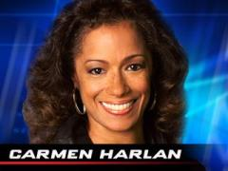
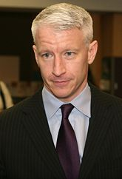
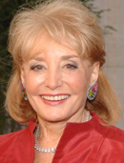
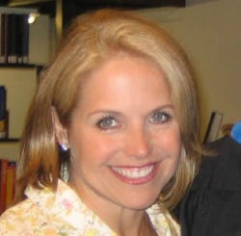

WHAT IS A JOURNALIST?
A person with a career in journalism.

Slide 5


ROLE OF JOURNALISTS
Political function: “watchdog” of government, monitor those in office
Economic function: inform readers about products, goods, services, events, prices

Slide 6
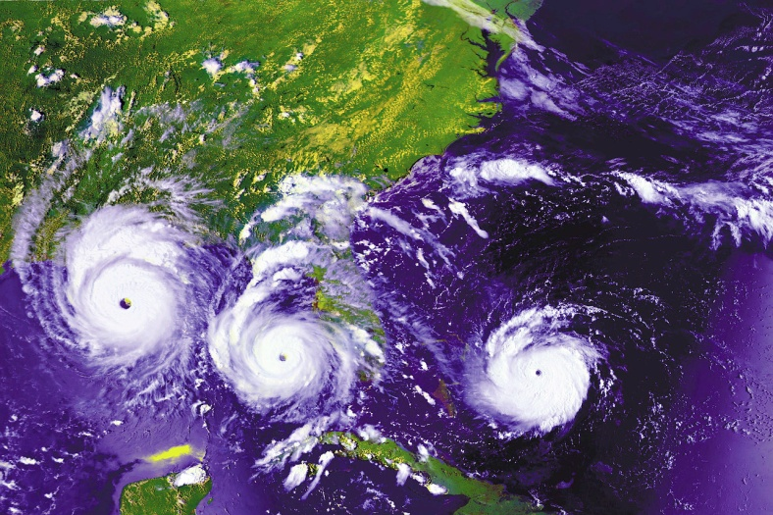
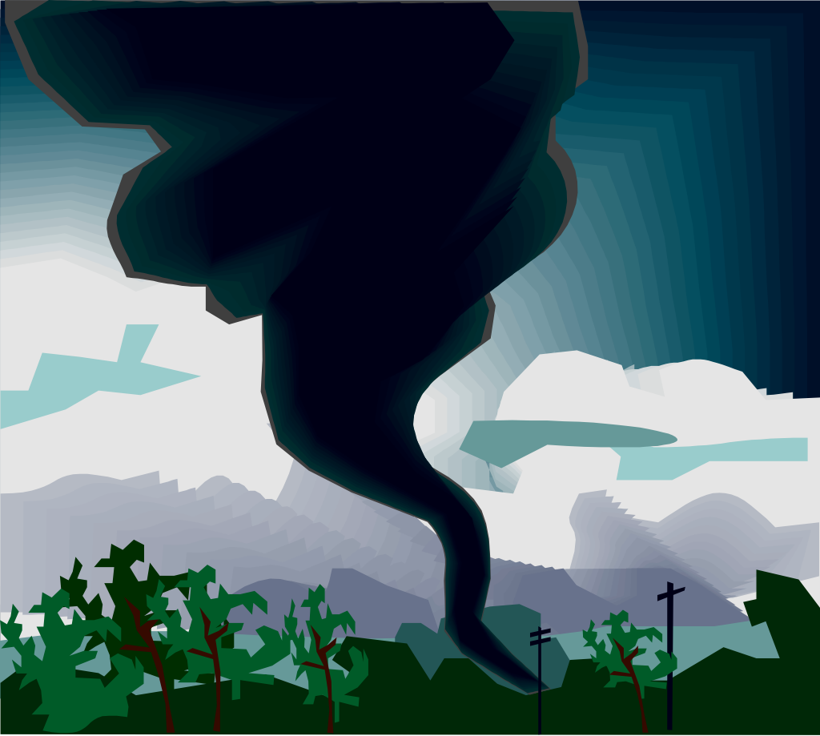
ROLE OF JOURNALISTS
Sentry function: press must tell us not only about what is going on today but also what is likely to happen tomorrow

Slide 7
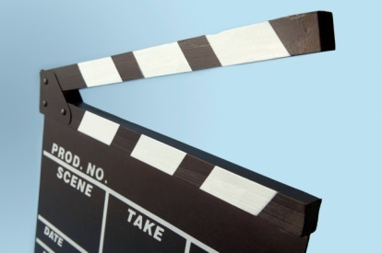
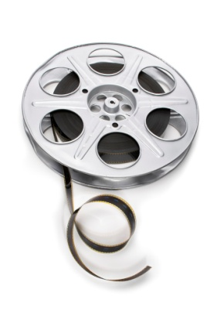
ROLE OF JOURNALISTS
Record-keeping function: keep accurate record of local, national, and world news
Entertainment function: provide a diversion from straight information

Slide 8



ROLE OF JOURNALISTS
Marketplace function: provide a variety of information on a variety of things

Slide 9


ROLE OF JOURNALISTS
Agenda-setting function: “while journalists don’t tell us what to think, they tell us what to think about”

Slide 10
Journalists’ Tools
What do journalists use to do their jobs?

Slide 11
1. First Amendment to the U.S. Constitution
“Congress shall make no law respecting an establishment of religion, or prohibiting the free exercise thereof; or abridging the freedom of speech, or of the press; or the right of the people peaceably to assemble, and to petition the government for a redress of grievances.”

Slide 12
Not so fast…exceptions to 1st Amendment
    Speech that is not protected= defamatory speech (attack on a person or organization’s good name)
      Libel= printed or published form of defamation
      Slander= spoken form of defamation

Slide 13
2. FOIA
  Freedom of Information Act: law ensuring public access to U.S. government records. Upon written request, agencies of the United States government are required to disclose those records, unless they can be lawfully withheld from disclosure under one of nine specific exemptions in the FOIA.

Slide 14
FOIA Exemptions
FOIA carries a presumption of disclosure; the burden is on the government - not the public - to substantiate why information may not be released.
You may have to pay for fees including:
  Fees for paper and ink costs
  Fees to pay someone to gather information

Slide 15
FOIA Exemptions
Threat to national security
Internal personnel rules and practices
  Of trivial nature
  Documents that circumvent a legal requirement
Information specifically exempt from other statutes
Trade secrets, commercial or financial info
Privileged inter-agency memos/letters
Personal info affecting one’s privacy
Investigation records compiled by law enforcement
Records of financial institutions
Geographical and geophysical info regarding wells

Slide 16
3. Interviews
One-on-one discussion format where the journalist (interviewer) asks the interviewee questions
  Closed-ended questions: can be answered with a simple “yes” or “no”
  Open-ended questions: require elaboration on the interviewee’s behalf

Slide 17
4. Press Conferences
Large interview-style format where one person, usually one of authority/power, is asked questions by multiple journalists

